Slide 1
Getting to Know Your Data
Data Mining* (CSC521)
Dr M Muzammal
*The instructor thanks Dr Jae-Gil Lee for sharing the lecture slides.

Slide 2

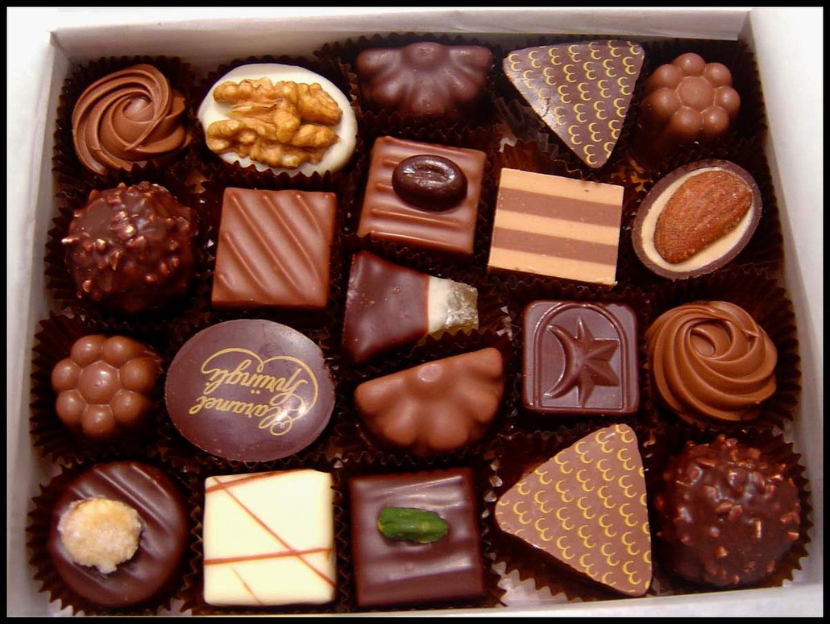
At the Beginning
My mom always said, "Life was like a box of chocolates. You never know what you're gonna get." (in Forrest Gump, 1994)

Slide 3

What am I looking at?

Slide 4

Data is Beautiful but Complicated! ☺

Slide 5

Before and After! ☺

Slide 6

Lee vs. AlphaGo

Slide 7
Contents
Types of Data Sets
Data Objects and Attribute Types
Basic Statistical Description of Data
Data Visualization Techniques
Data Similarity and Dissimilarity

Slide 8
Types of Data Sets
Record data
Relational records
Data matrix
Document data
Transaction or market basket data
Graph data
World Wide Web
Social networks
Molecular structures
Ordered
Sequential data or temporal data
Time-series data
Genetic sequence data
Trajectory data
…

Slide 9
Relational Records
Record Data
Data that consists of a collection of records, each of which consists of a fixed set of attributes

Slide 10
Data Matrix
Record Data
If data objects have the same fixed set of numeric attributes, the data objects can be thought of as points in a multi-dimensional space, where each dimension represents a distinct attribute
Such a data set can be represented by an m by n matrix, where there are m rows, one for each object, and n columns, one for each attribute
Projection of x Load | Projection of y Load | Distance | Load | Thickness
10.23 | 5.27 | 15.22 | 27 | 1.2
12.65 | 6.25 | 16.22 | 22 | 1.1
13.54 | 7.23 | 17.34 | 23 | 1.2
14.27 | 8.43 | 18.45 | 25 | 0.9

Slide 11
Document Data
Record Data
Each document becomes a term vector
Each term is a component (attribute) of the vector
The value of each component is the number of times the corresponding term occurs in the document

Slide 12
Transaction Data
Record Data
A special type of record data, where each record (transaction) involves a set of items
Also called market basket data
For example, the set of products purchased by a customer constitute a transaction, while the individual products that were purchased are the items

Slide 13
World Wide Web
Graph Data
A.Html
<a href=“B.html”>
B.Html
<a href=“D.html”>
D.Html
<a href=“E.html”>
C.Html
<a href=“B.html”>
<a href=“D.html”>
E.Html
<a href=“A.html”>
<a href=“B.html”>
The HTML links between web pages can be represented as a graph

Slide 14
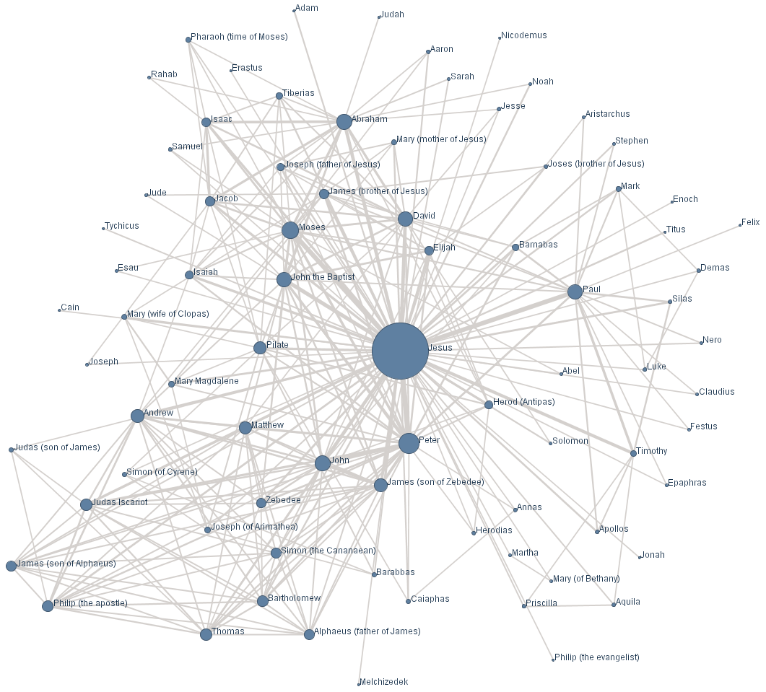
Social Network Data
Graph Data
Six degrees of separation:
the idea that everyone is on average approximately six steps away from any other person on Earth, so that a chain of, “a friend of a friend” statements can be made, on average, to connect any two people in six steps or fewer
The relationships (friends, followers) between users can be modeled as a graph

Slide 15
Molecular Structures
Graph Data
Benzene Molecule: C₆H₆
Chemical compounds originally have the graph structure

Slide 16
Sequential Data
Ordered Data
Time | Customer | Item Purchased
t1 | C1 | A, B
t2 | C3 | A, C
t2 | C1 | C, D
t3 | C2 | A, D
t4 | C2 | E
t5 | C1 | A, E
Sequences of transactions
Customer | Time and Items Purchased
C1 | < (A, B) (C, D) (A, E) >
C2 | < (A, D), (E) >
C3 | < (A, C) >

Slide 17
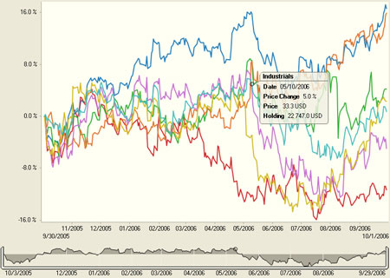
Time-Series Data
Ordered Data
one year of stock performance data for seven industrial sectors
Sequences of data points, measured typically at successive times spaced at uniform time intervals

Slide 18
Genetic Sequence Data
Ordered Data
Nucleic acids consist of a chain of linked units called nucleotides: A (adenine), C (cytosine), G (guanine), and T (thymine)

Slide 19
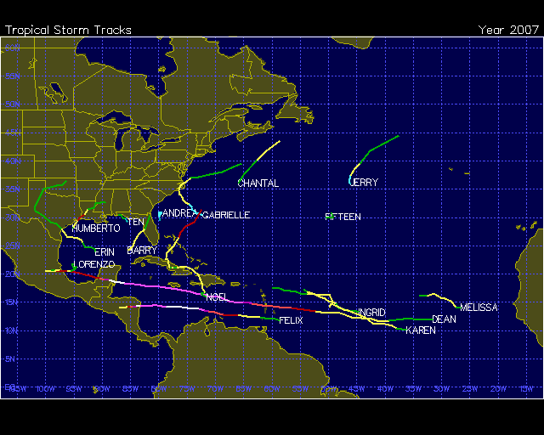
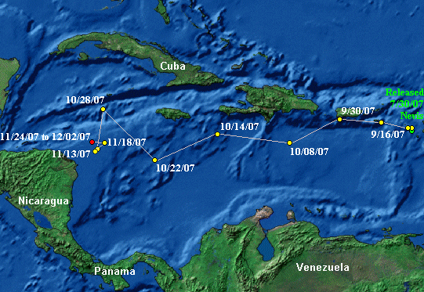
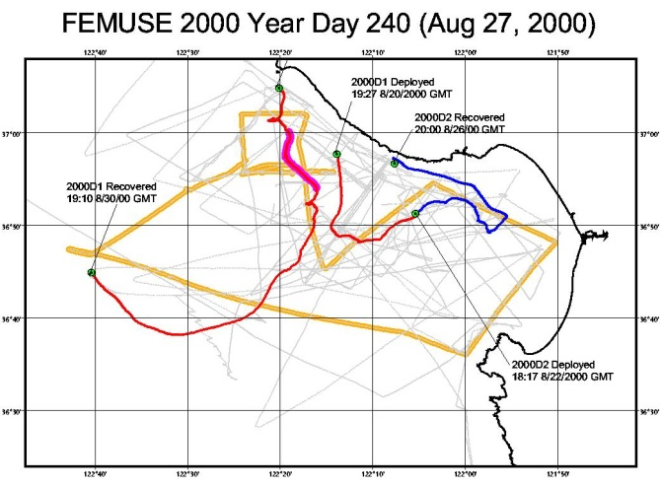
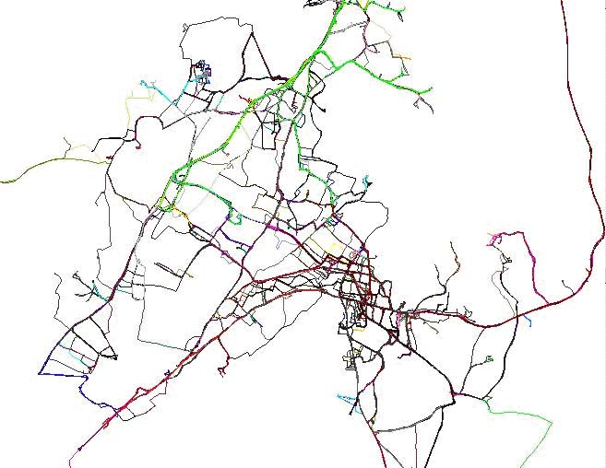
Trajectory Data
Ordered Data
Hurricanes
Turtles
Sequences of the locations and timestamps of moving objects
Vessels
Vehicles

Slide 20
Contents
Types of Data Sets
Data Objects and Attribute Types
Basic Statistical Description of Data
Data Visualization Techniques
Data Similarity and Dissimilarity

Slide 21
Data Objects
A data set can often be viewed as a collection of data objects
A data object (or sample, example, instance, point, tuple, …) represents an entry
Sales data sets: customers, store items, sales
Medical data sets: patients, treatments
University data sets: students, professors, courses
Data objects are described by attributes
In relational databases, rows are data objects; columns are attributes

Slide 22
Attributes
An attribute (or dimension, feature, …) is a property or characteristic of an object
e.g., eye color of a person, temperature of an object
Types
Categorical: qualitative
Nominal
Ordinal
Numeric: quantitative
Interval
Ratio

Slide 23
Categorical Attribute Types
Nominal: categories, states, or “names of things”
Values are just different names
Marital status, occupation, ID numbers (treated more like symbols), zip codes
Eye color = {brown, black, blue, green, hazel}
Binary
Nominal attribute with only 2 states (0 and 1)
Symmetric binary: both outcomes equally important
e.g., gender
Asymmetric binary: outcomes not equally important
e.g., medical test (positive vs. negative)
Convention: assigning 1 to most important outcome
e.g., HIV positive
Ordinal
Values have a meaningful order (ranking), but magnitude between successive values is not known
Sizes (= {small, medium, large}), grades, army rankings

Slide 24
Numeric Attribute Types
Interval
Values are measured on a scale of equal-sized units; values have order
e.g., temperature in C˚ or F˚, calendar dates
No true zero-point
e.g., 0 C˚ is, in a physical sense, arbitrary (cf. 0 K˚)
Ratio
Inherent zero-point
We can speak of values as being an order of magnitude larger than the unit of measurement (10 K˚ is twice as high as 5 K˚)
e.g., temperature in Kelvin, length, counts, monetary quantities

Slide 25
Attributes Types and Possible Data Analysis
 | Nominal | Ordinal | Interval | Ratio
frequency distribution | Yes | Yes | Yes | Yes
median and percentiles | No | Yes | Yes | Yes
add or subtract | No | No | Yes | Yes
mean, standard deviation, standard error of the mean | No | No | Yes | Yes
ratio or coefficient of variation | No | No | No | Yes
From: http://www.graphpad.com/support/faqid/1089/

Slide 26
Discrete vs. Continuous Attributes
Discrete attribute
A finite number of possible values
e.g., zip codes, profession, or the set of words in a collection of documents
Can be represented as integer variables
Continuous attribute
The rest of numeric attributes
e.g., temperature, height, or weight (some sort of physical measurement)
Typically represented as floating-point variables

Slide 27
Contents
Types of Data Sets
Data Objects and Attribute Types
Basic Statistical Description of Data
Data Visualization Techniques
Data Similarity and Dissimilarity

Slide 28
Basic Statistical Descriptions of Data
Measuring the central tendency
Measuring the dispersion of data
Graphic displays of basic statistical descriptions

Slide 29
Measuring the Central Tendency
Mean
Median
The middle value of the ordered set if the number of data is odd; otherwise, the average of the two middle values
Mode
The value that occurs most frequently in the set
Unimodal: only one mode 6 in [1, 3, 6, 6, 6, 6, 7, 7, 12, 12, 17]
Bimodal: two modes, e.g., [1, 1, 2, 4, 4]
Multimodal

Slide 30
Types of Measures
Distributive
A measure that can be computed for a given data set by partitioning the data into smaller subsets, computing the measure for each subset, and then merging the results in order to arrive at the measure’s value for the original (entire) data set
e.g., sum, count, min, max
Algebraic
A measure that can be computed by applying an algebraic function to one or more distributive measures
e.g., mean = sum / count
Holistic
A measure that must be computed on the entire data set as a whole
e.g., median

Slide 31
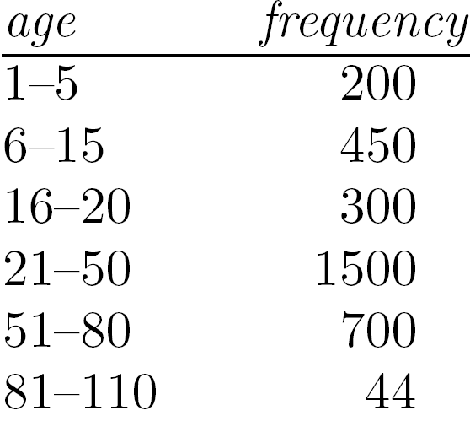
Approximation of the Median
The median value of a data set can be easily approximated by interpolation (for grouped data)
Let the interval that contains the median be the median interval
N: sum of frequencies
∑ freq: cumulative frequency before the median class
3194
950
21
30
1500

Slide 32
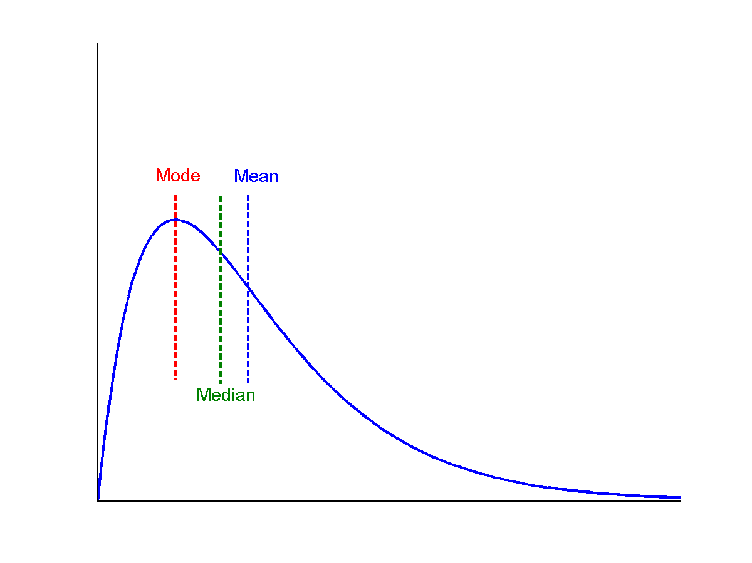
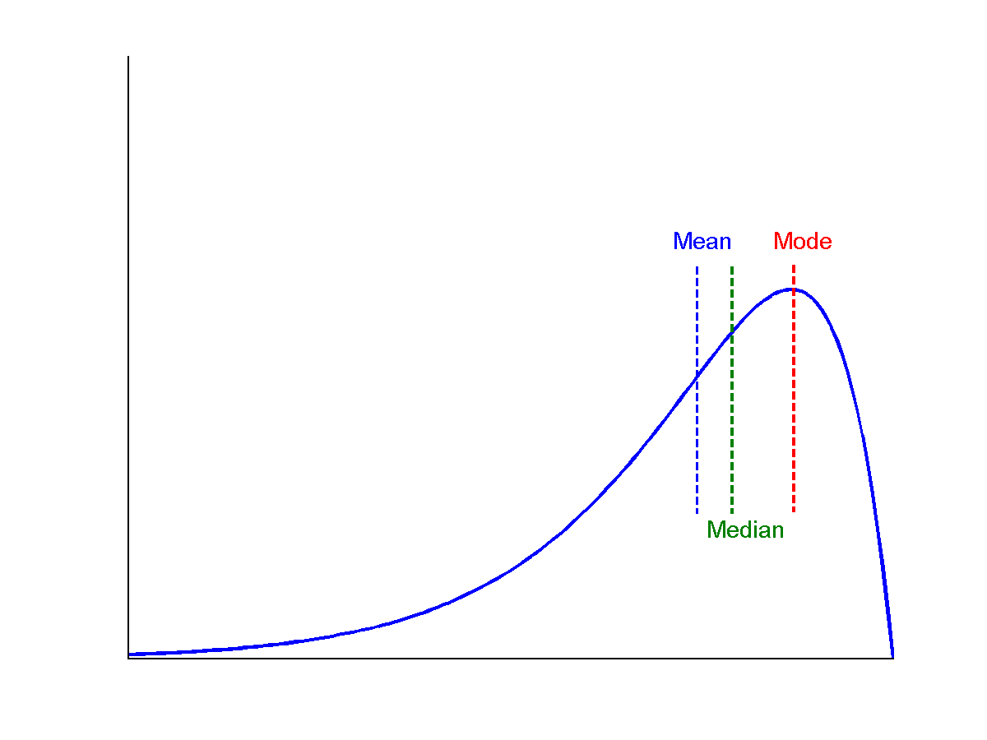
Symmetric vs. Skewed Data
Median, mean, and mode of symmetric, positively skewed, and negatively skewed data
symmetric
positively skewed
negatively skewed
Notes:
negative skew: The left tail is longer; the mass of the distribution is concentrated on the right of the figure. The distribution is said to be left-skewed, left-tailed, or skewed to the left.
positive skew: The right tail is longer; the mass of the distribution is concentrated on the left of the figure. The distribution is said to be right-skewed, right-tailed, or skewed to the right.

Slide 33
Measuring the Dispersion of Data
Quartiles
Quartiles: Q₁ (25th percentile), Q₃ (75th percentile)
Median: 50th percentile
Inter-quartile range: IQR = Q₃ – Q₁
Five number summary: min, Q₁, median, Q₃, max
Outlier: usually, a value higher/lower than 1.5 x IQR
Variance and standard deviation (sample: s, population: σ)
Variance (algebraic, scalable computation)
Standard deviation: s (or σ) is the square root of the variance

Slide 34
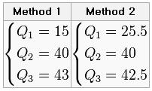
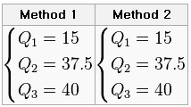
Quartile
There is no universal agreement on choosing the quartile values [Wikipedia]
Method 1
Use the median to divide the ordered data set into two halves. Do not include the median into the halves.
The lower quartile value is the median of the lower half of the data. The upper quartile value is the median of the upper half of the data.
Method 2
Use the median to divide the ordered data set into two halves. If the median is a datum (as opposed to being the mean of the middle two data), include the median in both halves.
Same as the above.
Example:
6, 7, 15, 36, 39, 40, 41, 42, 43, 47, 49
7, 15, 36, 39, 40, 41

Slide 35
Graphic Displays of Basic Statistical Descriptions
Boxplot
Histogram
Quantile plot
Quantile-quantile (q-q) plot
Scatter plot

Slide 36
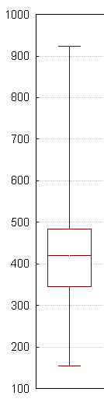
Box Plot
A convenient way of graphically depicting groups of numerical data through their five-number summaries: minimum, Q₁, median, Q₃, maximum
The ends of the box are at the first and third quartiles, i.e., the height of the box is IQR
The median is marked by a line within the box
Whiskers: two lines outside the box extended to the minimum and the maximum
Outliers: points beyond a specified outlier threshold, plotted individually

Slide 37
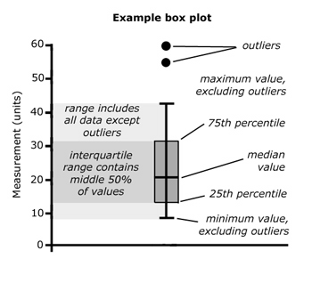
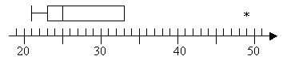
Box Plot and Outlier
Outlier:
A data point below Q₁ – 1.5×IQR or above Q₃ + 1.5×IQR
Example:
Data points: 21, 23, 24, 25, 29, 33, 49
Q₂ = 25, Q₁ = 23, Q₃ = 33, IQR = 10
Outlier: below 23 – 1.5*10 = 8 or above 33 + 1.5*10 = 48
Box plot:
outlier

Slide 38
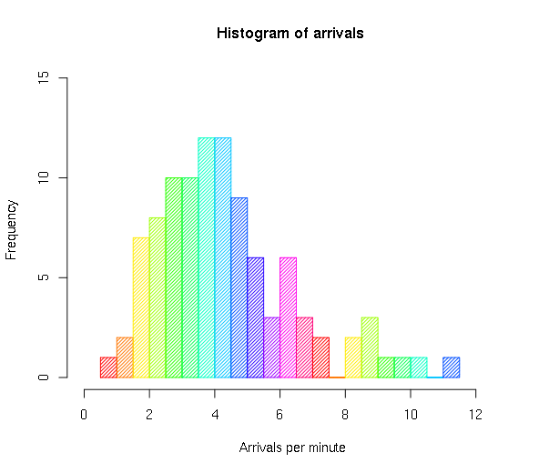
Histogram (1/2)
A graphical representation, showing a visual impression of the distribution of data
A histogram consists of tabular frequencies, shown as adjacent rectangles
The height of a rectangle is equal to the frequency density of the interval, i.e., frequency / width of the interval
The total area is equal to the number of data

Slide 39
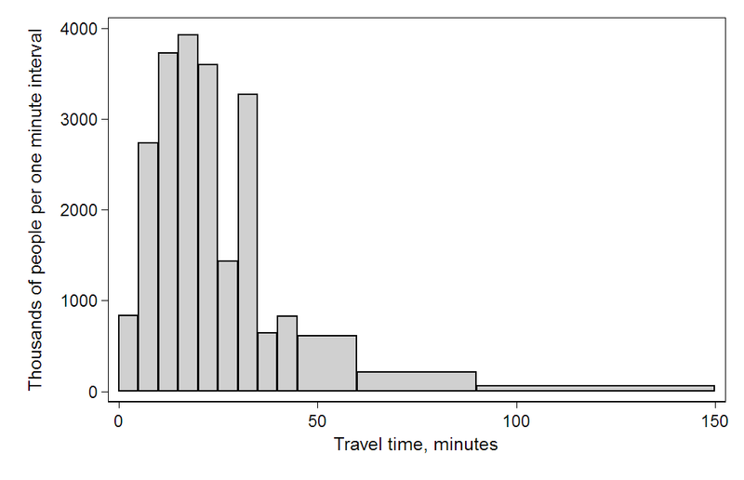
Histogram (2/2)
Interval | Width | Quantity | Quantity/width
0 | 5 | 4180 | 836
5 | 5 | 13687 | 2737
10 | 5 | 18618 | 3723
15 | 5 | 19634 | 3926
20 | 5 | 17981 | 3596
25 | 5 | 7190 | 1438
30 | 5 | 16369 | 3273
35 | 5 | 3212 | 642
40 | 5 | 4122 | 824
45 | 15 | 9200 | 613
60 | 30 | 6461 | 215
90 | 60 | 3435 | 57

Slide 40
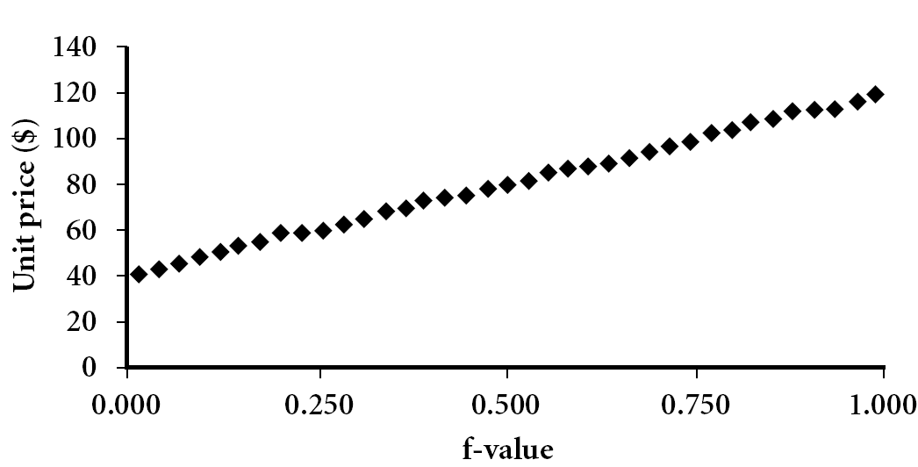
Quantile Plot
A plot of quantiles
For a value x_{i}, when data are sorted in increasing order, f_{i} indicates that approximately 100 f_{i}% of the data are below or equal to x_{i}
The k^{th} q-quantile for a random variable is the value x such that the probability that the random variable will be less than x is at most k / q
Special names: 4-quantile→ quartile, 100-quantile→ percentile

Slide 41
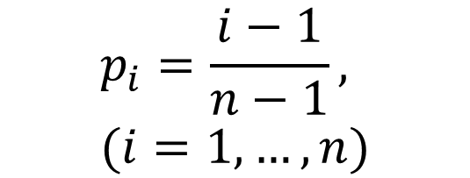
An Example of Quantile
Using R:
> x=c(1.3, 2.2, 2.7, 3.1, 3.3, 3.7)
> quantile(x)
0% 25% 50% 75% 100%
1.300 2.325 2.900 3.250 3.700
> quantile(x, seq(0, 1, by=0.2))
0% 20% 40% 60% 80% 100%
1.3 2.2 2.7 3.1 3.3 3.7
Order statistics
$$p_{i}=\frac{i−1}{n−1}, (i=1, …, n)$$

Slide 42
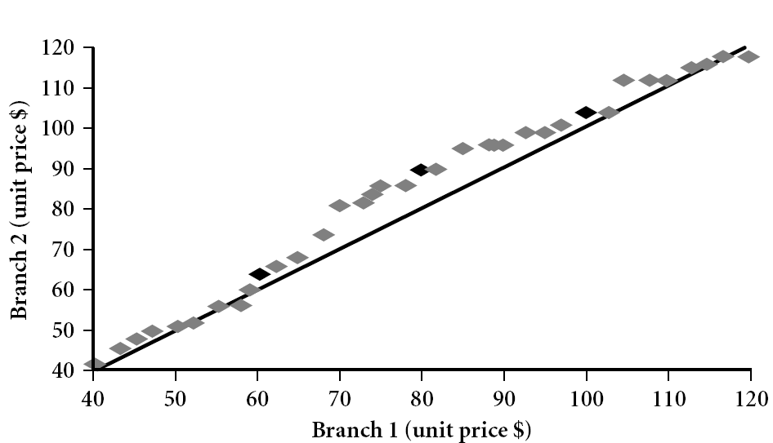
Quantile-Quantile Plot (1/2)
A graphical method for comparing two probability distributions by plotting their quantiles against each other
The example shows the unit price of items sold at Branch 1 vs. Branch 2 for each quantile. For expensive products, unit prices of items sold at Branch 1 tend to be lower than those at Branch 2.
Q₃
median
Q₁
Notes:
Tell audience: There is a shift in distribution of branch 1 WRT branch 2 in that the unit prices of items sold at branch 1 tend to be lower than those at branch 2.
A Q-Q plot is used to compare the shapes of distributions, providing a graphical view of how properties such as location, scale, and skewness are similar or different in the two distributions.

Slide 43
Quantile-Quantile Plot (2/2)
Interpretation [from Wikipedia]
If the two distributions being compared are identical, the Q-Q plot follows the line y = x
If the two distributions agree after linearly transforming the values in one of the distributions, then the Q-Q plot follows some line, but not necessarily the line y = x
If the general trend of the Q-Q plot is flatter than the line y = x, the distribution plotted on the horizontal axis is more dispersed than the distribution plotted on the vertical axis
If the general trend of the Q-Q plot is steeper than the line y = x, the distribution plotted on the vertical axis is more dispersed than the distribution plotted on the horizontal axis
Q-Q plots are often arced, or “S” shaped, indicating that one of the distributions is more skewed than the other, or that one of the distributions has heavier tails than the other

Slide 44
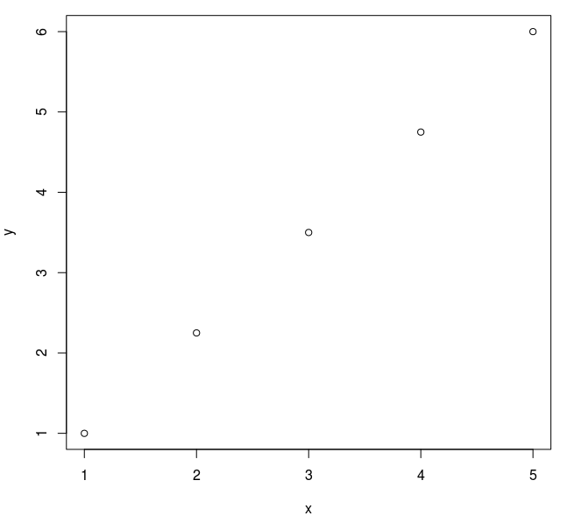
An Example of Q-Q Plots
Different number of values
x = {1, 2, 3, 4, 5}
y = {1, 2, 3, 4, 5, 6}
Using R:
> x <- 1:5
> y <- 1:6
> qqplot(x, y)

Slide 45
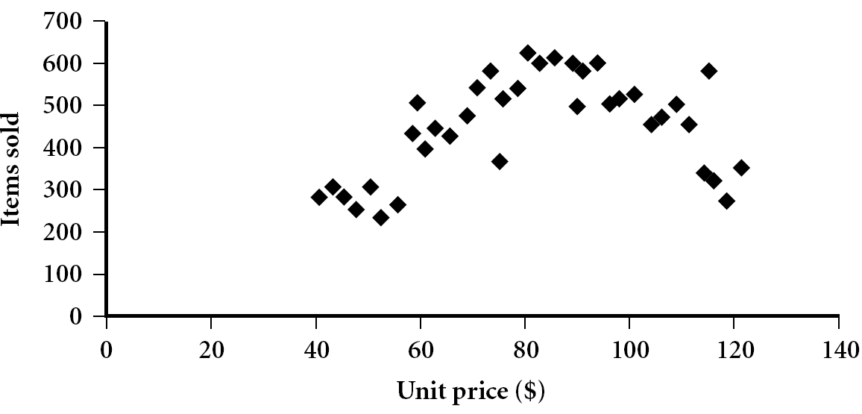
Scatter Plot
A type of mathematical diagram using Cartesian coordinates to display values for two variables for a set of data

Slide 46
Positively and Negatively Correlated Data
Positively correlated
Negatively correlated

Slide 47
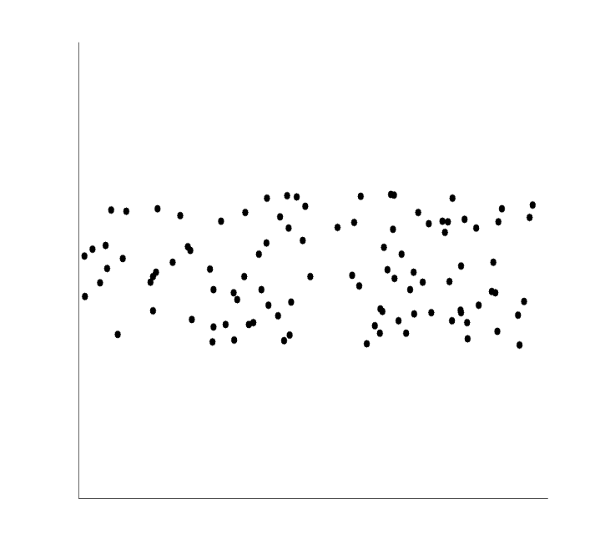
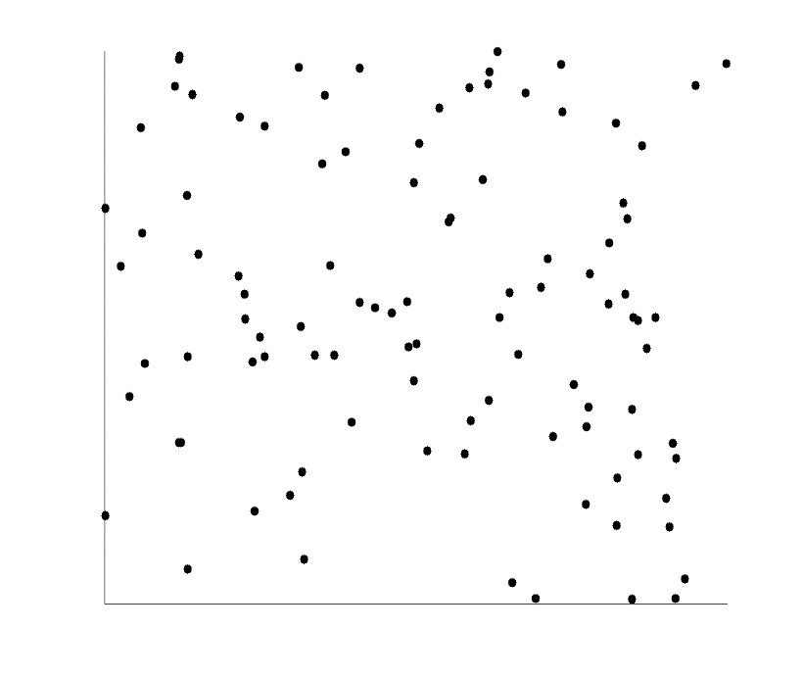
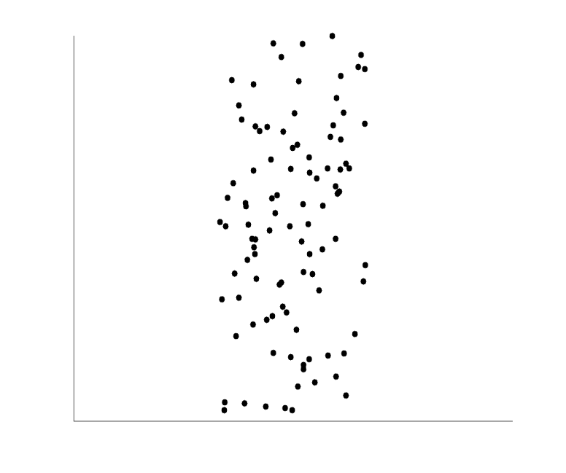
Uncorrelated Data

Slide 48
Contents
Types of Data Sets
Data Objects and Attribute Types
Basic Statistical Description of Data
Data Visualization Techniques
Data Similarity and Dissimilarity

Slide 49
Data Visualization
Why data visualization?
To gain insight into an information space by mapping data onto graphical primitives
To provide qualitative overview of large data sets
To search for patterns, trends, structure, irregularities, relationships among data
To help find interesting regions and suitable parameters for further quantitative analysis
To provide a visual proof of computer representations derived
A picture is worth a thousand words.

Slide 50
Scopes
Statistical graphics
Scatter plots, histograms, box plots, and so on
Thematic cartography
A type of map or chart especially designed to show a particular theme connected with a specific geographic area
Choropleth
Proportional symbol
Isarithmic
Dot
Dasymetric
…
Notes:
choropleth
미국∙영국 [|kɔ:rə|plɛθ]

Slide 51
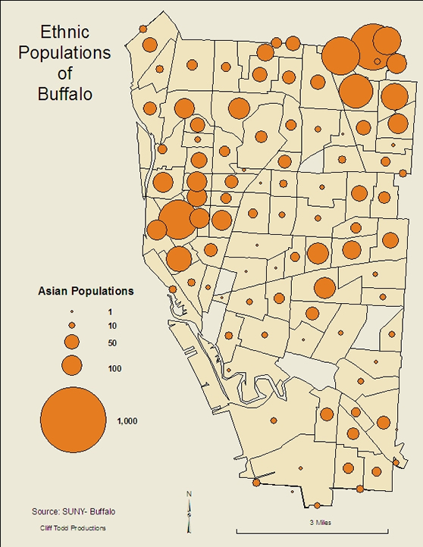
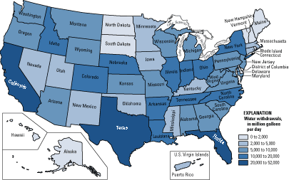
Examples of Thematic Cartography (1/3)
Choropleth map of water use
Proportional symbol
Notes:
Cartographers use many methods to create thematic maps, but five techniques are especially noted.
[edit]Choropleth
Choropleth mapping shows statistical data aggregated over predefined regions, such as counties or states, by coloring or shading these regions. For example, countries with higher rates of infant mortality might appear darker on a choropleth map. This technique assumes a relatively even distribution of the measured phenomenon within each region.
[edit]Proportional symbol
The proportional symbol technique uses symbols of different sizes to represent data associated with different areas or locations within the map. For example, a disc may be shown at the location of each city in a map, with the area of the disc being proportional to the population of the city.
[edit]Isarithmic
Isarithmic maps, also known as contour maps, depict smooth continuous phenomena such as precipitation.
[edit]Dot
A dot may be used to locate each occurrence of a phenomenon, as in Dr. Snow's map where each dot represented one death due to cholera. Where appropriate, a dot may indicate any number of entities, for example, one dot for every 100 voters.
[edit]Dasymetric
A dasymetric map is similar to a choropleth map, but one in which the regions are not predefined but chosen so that the distribution of the measured phenomenon within each region is relatively uniform. The boundaries may be much sharper than in an isarithmic map. For example, planning regulations may lead to adjacent regions in a dasymetric map of population density being internally homogeneous but at opposite extremes. These maps are more difficult to generate and less common than other types.

Slide 52
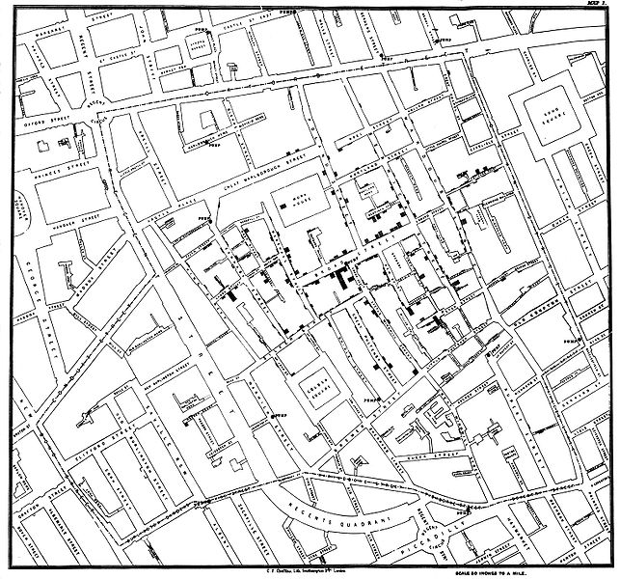
Examples of Thematic Cartography (2/3)
In the 1850s, John Snow performed pioneering data analysis to prove his hypothesis that cholera was spread by the drinking of water infected with cholera bacteria.
…
The cholera outbreak occurred in the Soho District of London, in and around Broad Street. As shown in the left figure, Dr. Snow plotted each cholera case on a map and also plotted houses with multiple cases. The cases were not distributed uniformly, but rather were distributed in a tight cluster around a water pump located on Broad Street (now Broadwick Street). Dr. Snow disabled the water pump by removing its handle. The Broad Street cholera outbreak stopped almost literally overnight.
Original map by Dr. John Snow showing the clusters of cholera cases in the London epidemic of 1854

Slide 53
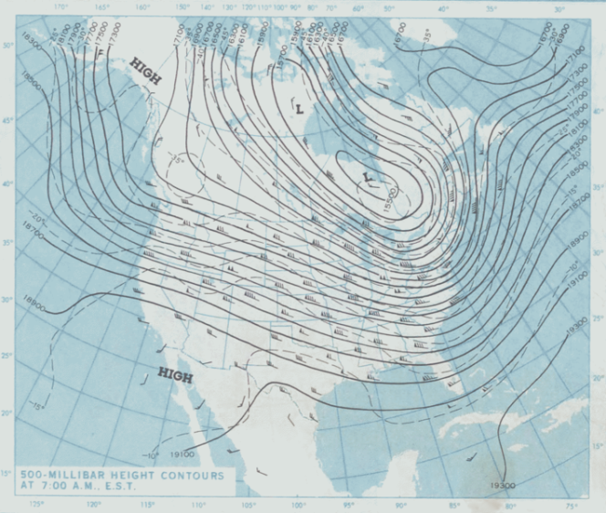
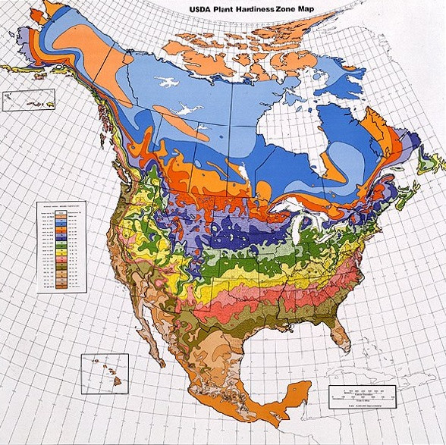
Examples of Thematic Cartography (3/3)
Isarithmic map of barometric pressure
Dasymetric map of climate and plant hardiness zones

Slide 54
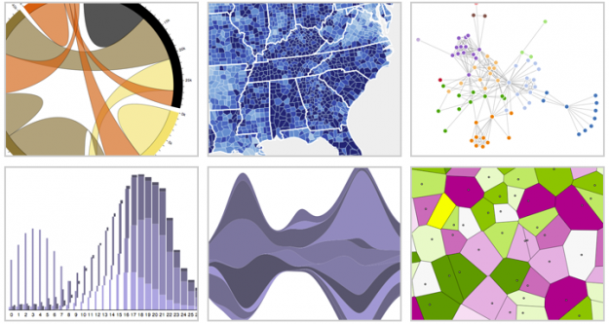
Interesting Examples of Data Visualization (1/2)
Data-driven documents
Browsers keep getting better, and it grows easier every day to visualize data native in the browser
JavaScript visualization libraries
Protovis: http://mbostock.github.com/protovis/
Polymaps: http://polymaps.org/
Processing.js: http://processingjs.org/
D3: http://mbostock.github.com/d3/

Slide 55
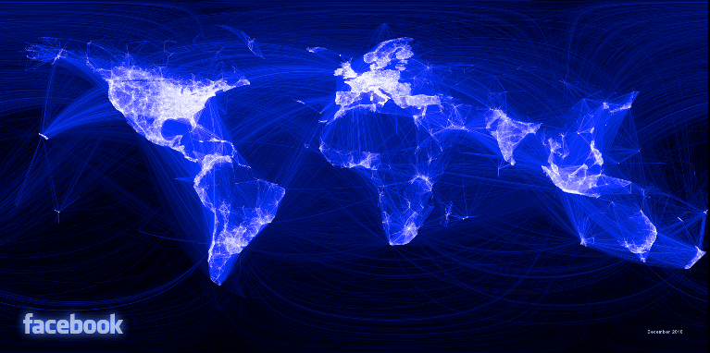
Interesting Examples of Data Visualization (2/2)
Visualizing friendship on Facebook

Slide 56

Discussion
Good visualizations for a recommendation?
Is this explanation good enough?

Slide 57
Contents
Types of Data Sets
Data Objects and Attribute Types
Basic Statistical Description of Data
Data Visualization Techniques
Data Similarity and Dissimilarity

Slide 58
Similarity and Dissimilarity
Similarity
Numerical measure of how alike two data objects are
Higher when objects are more alike
Often in the range [0,1]
Dissimilarity (e.g., distance)
Numerical measure of how different two data objects are
Lower when objects are more alike
Often starting from 0
∗ Proximity refers to a similarity or dissimilarity

Slide 59
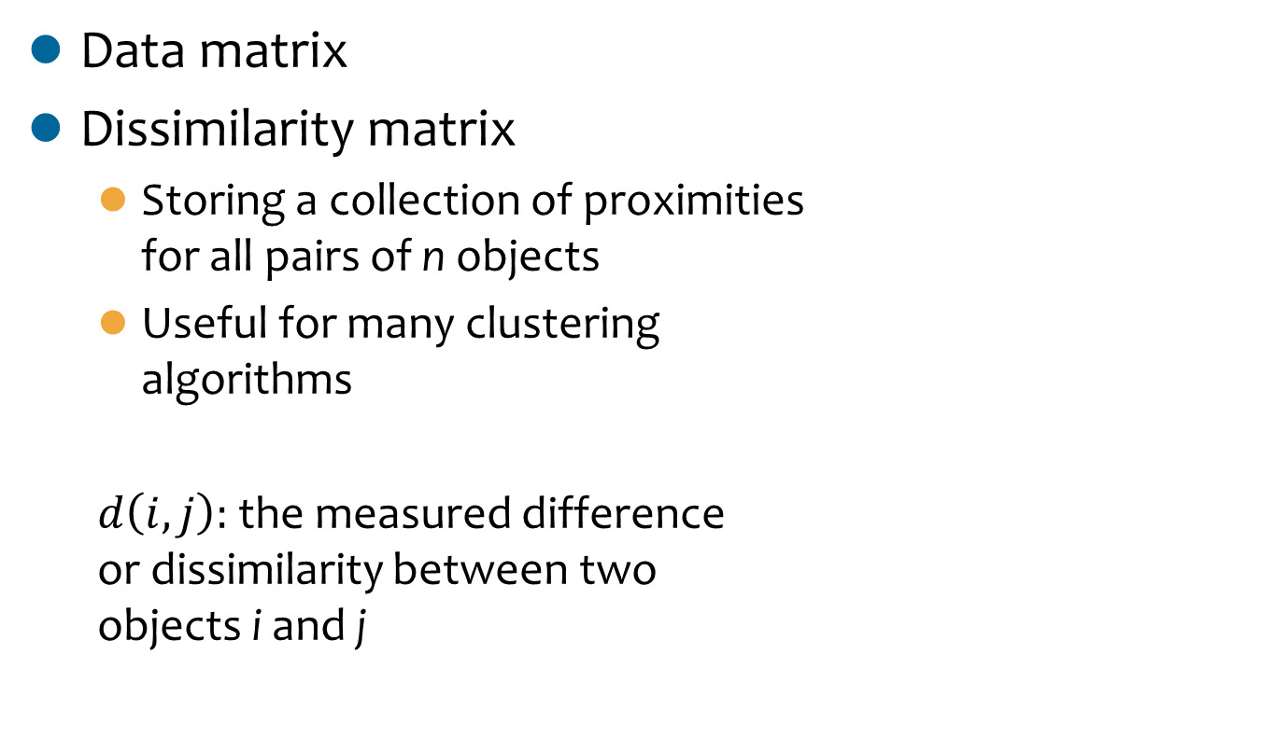
Data Matrix and Dissimilarity Matrix

Slide 60
Standardizing Numeric Data
The measurement unit used can affect data analysis due to varying sizes of the differences
e.g., weight in pounds and kilograms
The data should be standardized to avoid dependency of measurement units
e.g., { 1 lb, 2 lb, 3 lb } vs. { 0.45 kg, 0.90 kg, 1.35 kg } ⇒ { -1.5, 0, 1.5 }
Standardization may or may not be useful in a particular application

Slide 61
Z-score
A standard score indicates how many standard deviations a datum is above or below the mean
x: raw score to be standardized, μ: mean of the population, σ: standard deviation
An alternative way
Mean absolute deviation
where

Slide 62
Dissimilarity between Nominal Attributes
The dissimilarity between two objects i and j can be computed based on the ratio of mismatches
m: # of matches, p: total # of attributes
An alternative way
Using a large number of asymmetric binary attributes by creating a new binary attribute for each of the M nominal states

Slide 63
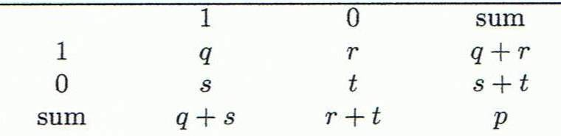
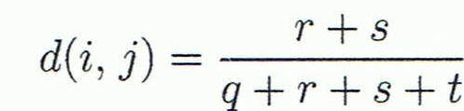
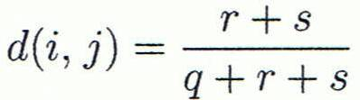
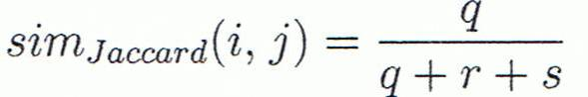
Dissimilarity between Binary Attributes (1/2)
Object j
A contingency table for binary data
Distance measure for symmetric binary variables
Distance measure for asymmetric binary variables
Jaccard coefficient (similarity measure for asymmetric binary variables)
Object i

Slide 64
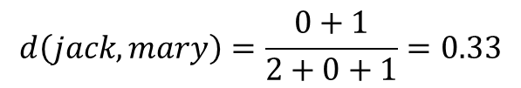
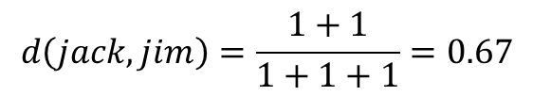
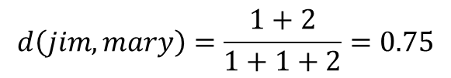
Dissimilarity between Binary Attributes (2/2)
An example
Gender is a symmetric attribute
The remaining attributes are asymmetric binary
Let the values Y and P be 1, and the value N 0

Slide 65
Distance on Numeric Attributes: Minkowski Distance
where i = (x_{i1}, x_{i2}, …, x_{ip}) and j = (x_{j1}, x_{j2}, …, x_{jp}) are two p-dimensional data objects, and h is the order (the distance so defined is also called L-h norm)

Slide 66
Special Cases of Minkowski Distance
h = 1: Manhattan (city block, L₁ norm) distance
e.g., the Hamming distance: the number of bits that are different between two binary vectors
h = 2: (L₂ norm) Euclidean distance
h → ∞: “supremum” (L_{max} norm, L∞ norm) distance
This is the maximum difference between any component (attribute) of the vectors

Slide 67
Examples of the Minkowski Distance
Manhattan (L₁)
Euclidean (L₂)
Supremum

Slide 68
Common Properties of a Distance
Distances, such as the Euclidean distance, have some well known properties
d(p, q) ≥ 0 for all p and q and d(p, q) = 0 only if p = q (Positive definiteness)
d(p, q) = d(q, p) for all p and q (Symmetry)
d(p, r) ≤ d(p, q) + d(q, r) for all points p, q, and r (Triangle Inequality)
where d(p, q) is the distance (dissimilarity) between points (data objects) p and q
A distance that satisfies these properties is called a metric

Slide 69

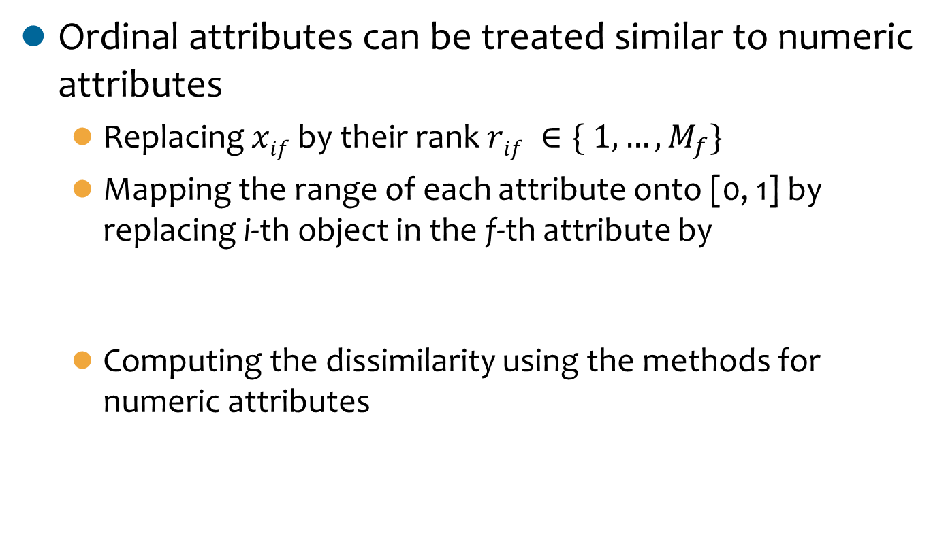
Dissimilarity between Ordinal Attributes
Ordinal attributes can be treated similar to numeric attributes
Replacing $xif$by their rank $rif ∈\{ 1, …, M_{f}\}$
Mapping the range of each attribute onto [0, 1] by replacing i-th object in the f-thattribute by
Computing the dissimilarity using the methods for numeric attributes
$$zif= \frac{rif −1}{Mf −1}$$

Slide 70
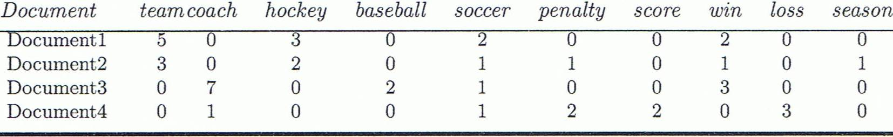
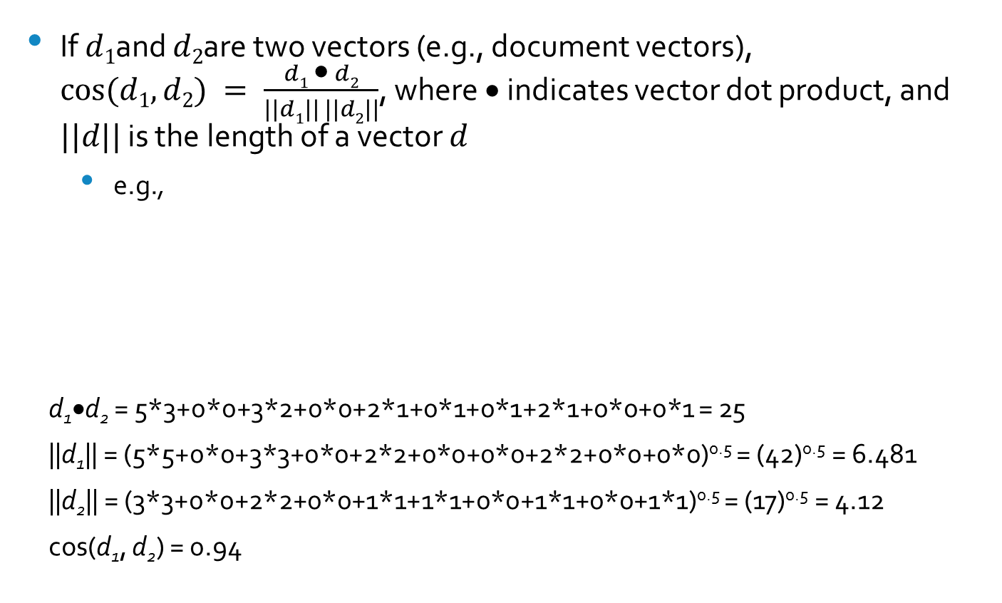
Cosine Similarity
If $d1$and $d2$are two vectors (e.g., document vectors), $cos⁡(d1, d2) = \frac{d1 • d2}{||d1|| ||d2||}$, where • indicates vector dot product, and $||d||$ is the length of a vector $d$
e.g.,
d₁•d₂ = 5*3+0*0+3*2+0*0+2*1+0*1+0*1+2*1+0*0+0*1 = 25
||d₁|| = (5*5+0*0+3*3+0*0+2*2+0*0+0*0+2*2+0*0+0*0)^{0.5} = (42)^{0.5} = 6.481
||d₂|| = (3*3+0*0+2*2+0*0+1*1+1*1+0*0+1*1+0*0+1*1)^{0.5} = (17)^{0.5} = 4.12
cos(d₁, d₂) = 0.94

Slide 71
Handling Mixed Types
Data objects are described by a mixture of attribute types: nominal, symmetric binary, asymmetric binary, numeric, and ordinal
The dissimilarity d(i, j) between two objects i and j is defined as a weighted sum of the distance for each attribute, where each distance is normalized into [0, 1]

Slide 72
Thank You!
Any Questions?

